Slide 1
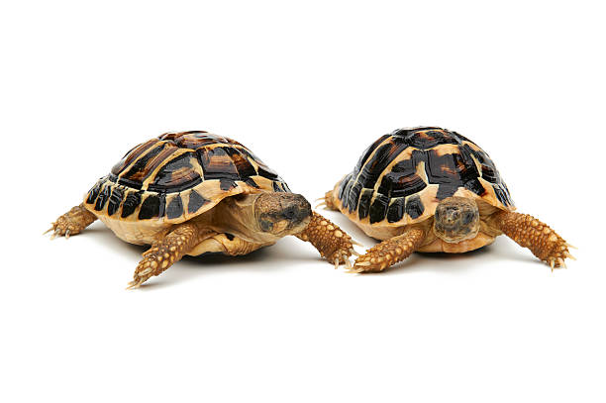
Elmer and Elsie Milestone in AI
Alan van Hassel

Slide 2
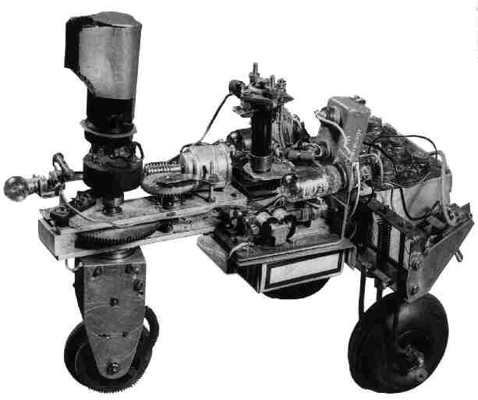
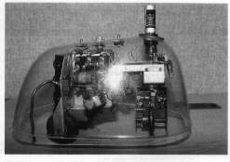
First autonomous robots
1948, William Grey

Slide 3
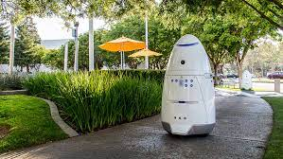
Importance of environment

Slide 4
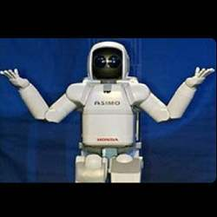
Questions?

